Slide 1

MATCH MASTER
By:
Dhiraj Sapkota
Elisha Rai
Sagar Upadhyaya

Slide 2
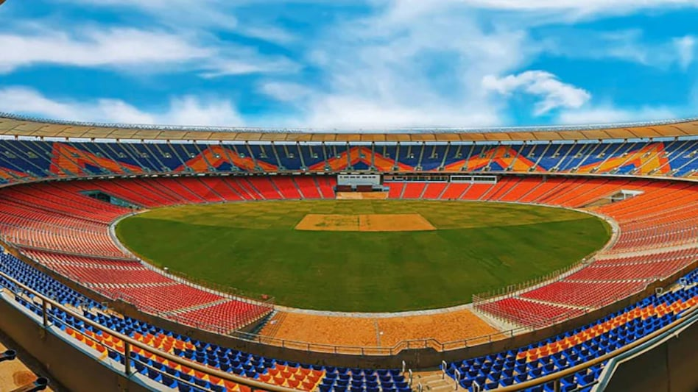
Table of Content
Introduction
Problem Statement
Motivation
Objectives
Features
Tools and Technology
Gantt Chart
Conclusion

Slide 3

Introduction
Match Master is a project that predicts team scores and winning probabilities in IPL matches, making cricket analysis exciting and accessible.

Slide 4
Problem Statement
Handling large volumes of historical data.
real-time data input/output for match predictions.
Limited accuracy for predictions due to missing venue
Lack of Interpretability of prediction models

Slide 5
Motivation
Exploring the Realm of Sports Analytics
Personal Interest in Cricket
Enhancing Fan Engagement

Slide 6

Objectives
To develop a model that can predict :
Cricket Score
Winning probability of the team

Slide 7

Features
Real-time Predictions
Match Momentum Tracking
Historical Data Analysis
Match Outcome
Player Statistics
Team Performance
Venue & more
Interactive data rendering

Slide 8
Proposed Methodology
Data Collection :
In this steps we take a historical data of IPL from 2008 to 2023 (delivery/match)
Data Preprocessing :
In this steps we clean and organize the data into a format suitable for analysis
Model Training :
In this steps we choose a machine learning algorithm
(e.g., Random Forest, Logistic Regression and XGBoost Regression).
Then we train the model on the prepared historical data.
This involves feeding the data into the algorithm and allowing it to learn from the patterns and relationships within the data
Prediction Generation :
Once trained, the model can analyze data and based on this analysis, the model generates a prediction for the match outcome
Model deploy on the website using flask and take some input from the user and predict

Slide 9
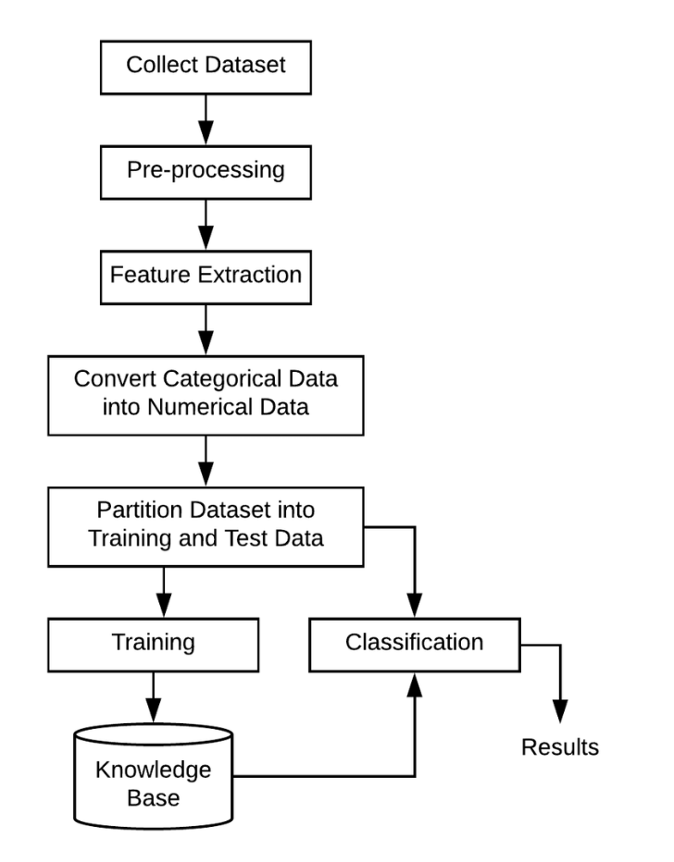
Workflow

Slide 10
Tools and Technology
Tools :
Jupyter Notebook
Visual Studio
Technology :
Machine Learning Algorithm: (Random Forest, Logistic Regression, XGBoost Regression)
Libraries like NumPy, Pandas, Scikit-learn

Slide 11
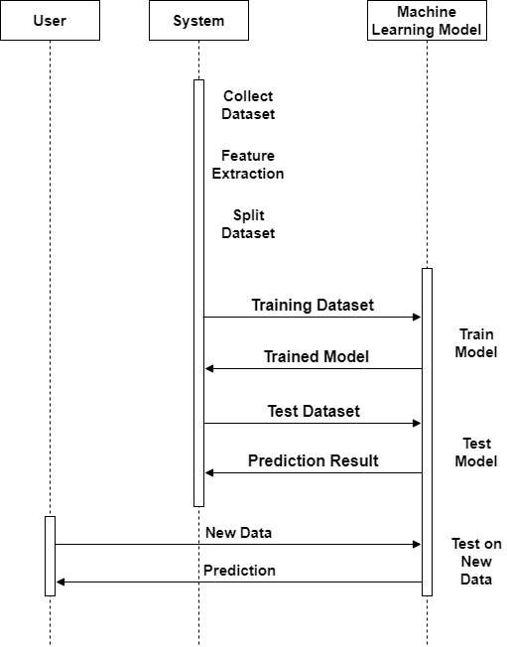
Sequence Diagram

Slide 12
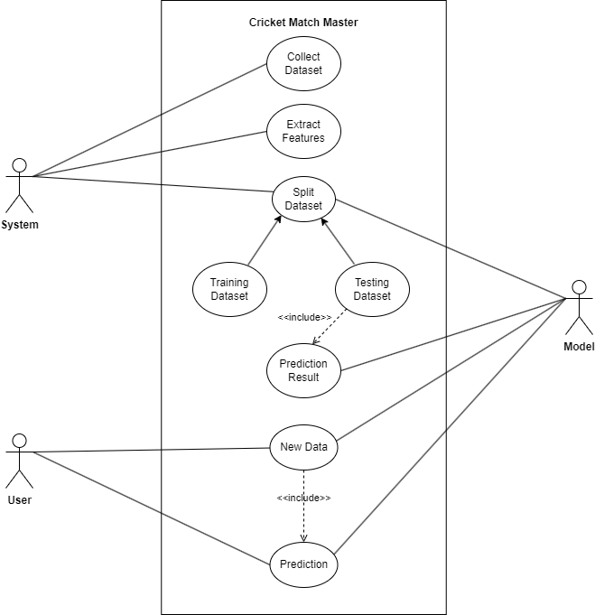
Use Case Diagram

Slide 13
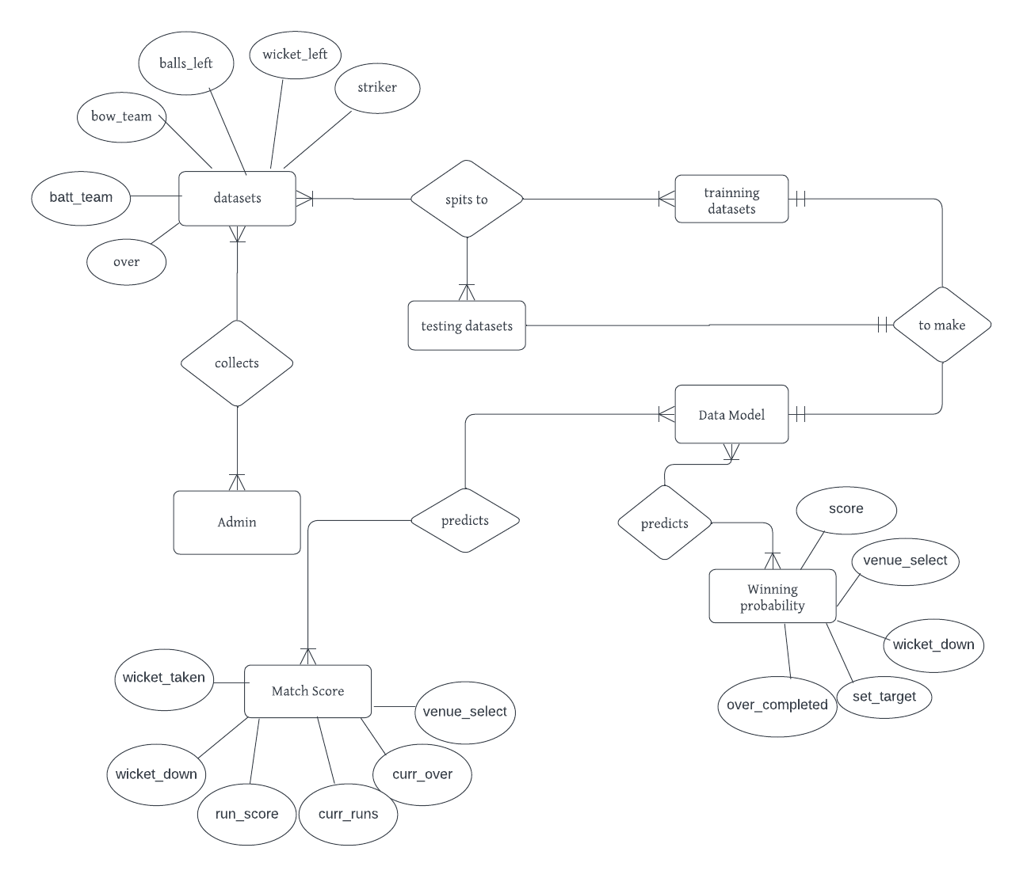
ER Diagram

Slide 14
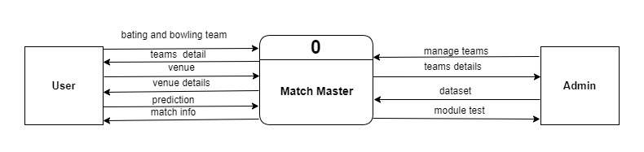
DFD Level 0

Slide 15
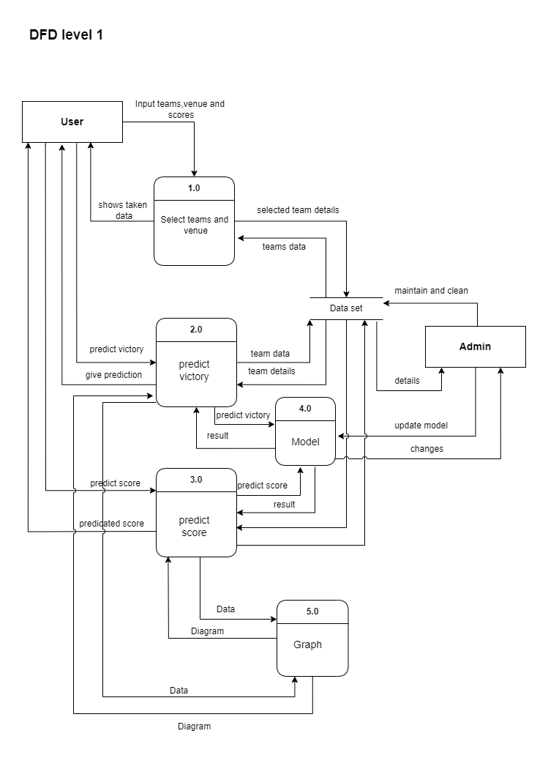
DFD Level 1

Slide 16
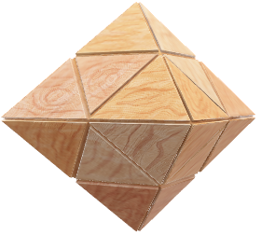
Gantt Graph
Months
April
May
June
July
August
September
Requirements Gathering
System Design
Coding
Testing and Debugging
Documentation
Today

Slide 17
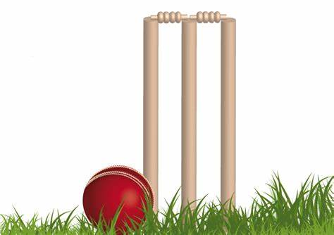
Conclusion
Match Master uses ML to predict cricket scores and
winning chances, making cricket more fun and
understandable for fans.

Slide 18
Future Enhancement
Weather & Pitch Analysis:
Mobile App Version
Explainable AI
Multilingual Support
Player and Team Form Impact

Slide 19
References
Saji, B. (2024, May 28). IPL Team Win Prediction Project Using Machine Learning. Analytics Vidhya. https://www.analyticsvidhya.com/blog/2022/05/ipl-team-win-prediction-project-using-machine-learning/
Shukla, P. (2022, October 31). Building an IPL Score Predictor – End-To-End ML Project. Analytics Vidhya. https://www.analyticsvidhya.com/blog/2021/10/building-an-ipl-score-predictor-end-to-end-ml-project/
GeeksforGeeks. (2024, June 10). IPL Score Prediction using Deep Learning. GeeksforGeeks. https://www.geeksforgeeks.org/ipl-score-prediction-using-deep-learning/

Slide 20

Thank you

